Slide 1



Citibike Insights – February – April 2019
View in Power BI
Last data refresh:
8/11/2019 3:51:59 PM Eastern Standard Time
Downloaded at:
8/11/2019 3:54:57 PM Eastern Standard Time

Slide 2
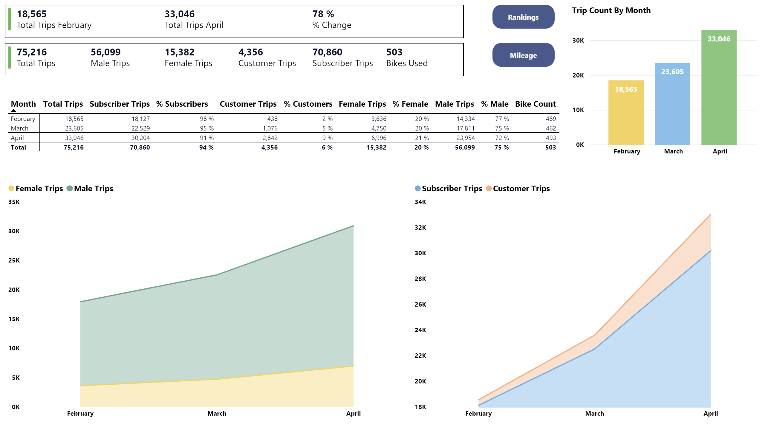
1
2
3

Slide 3
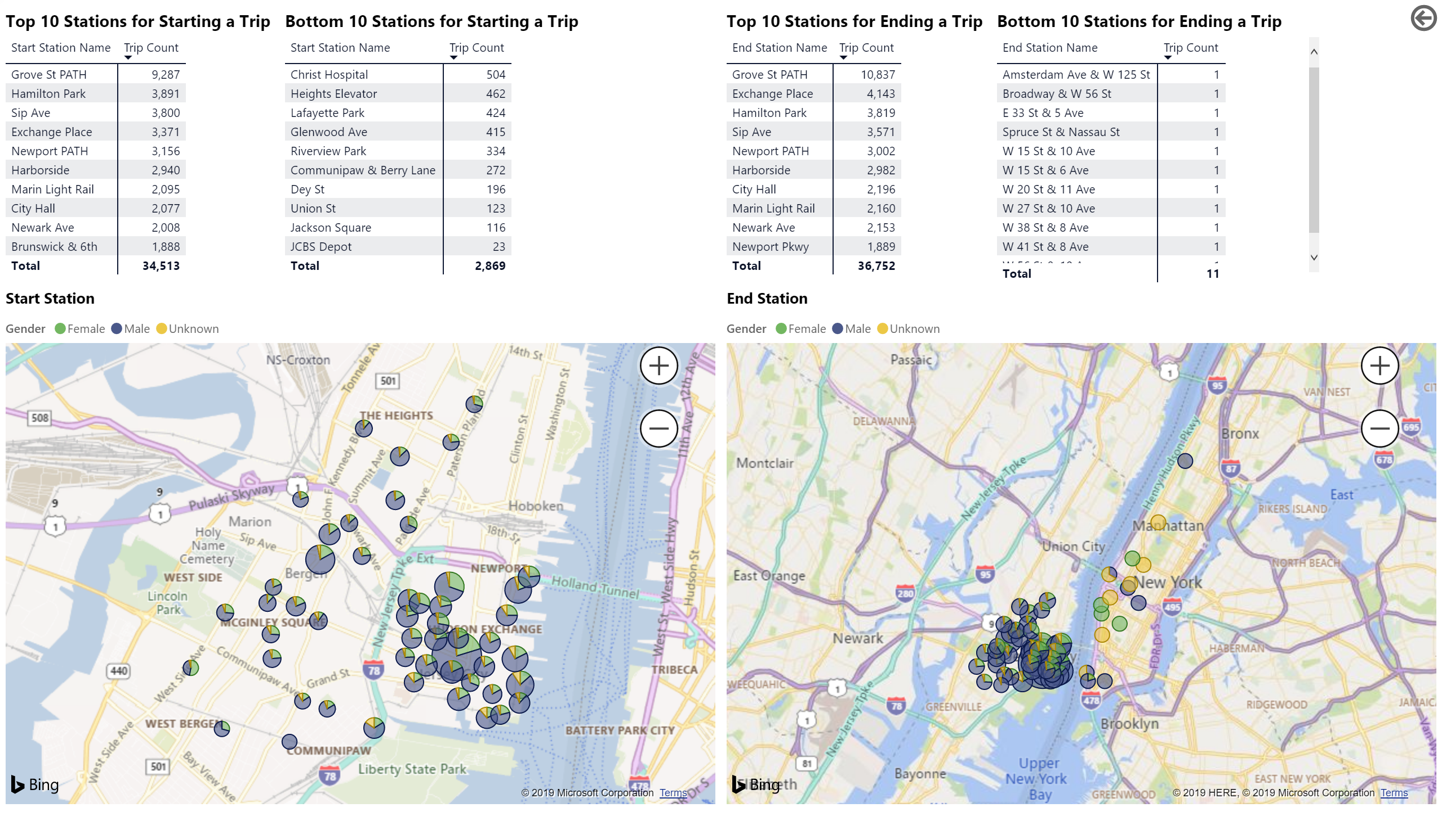

Slide 4
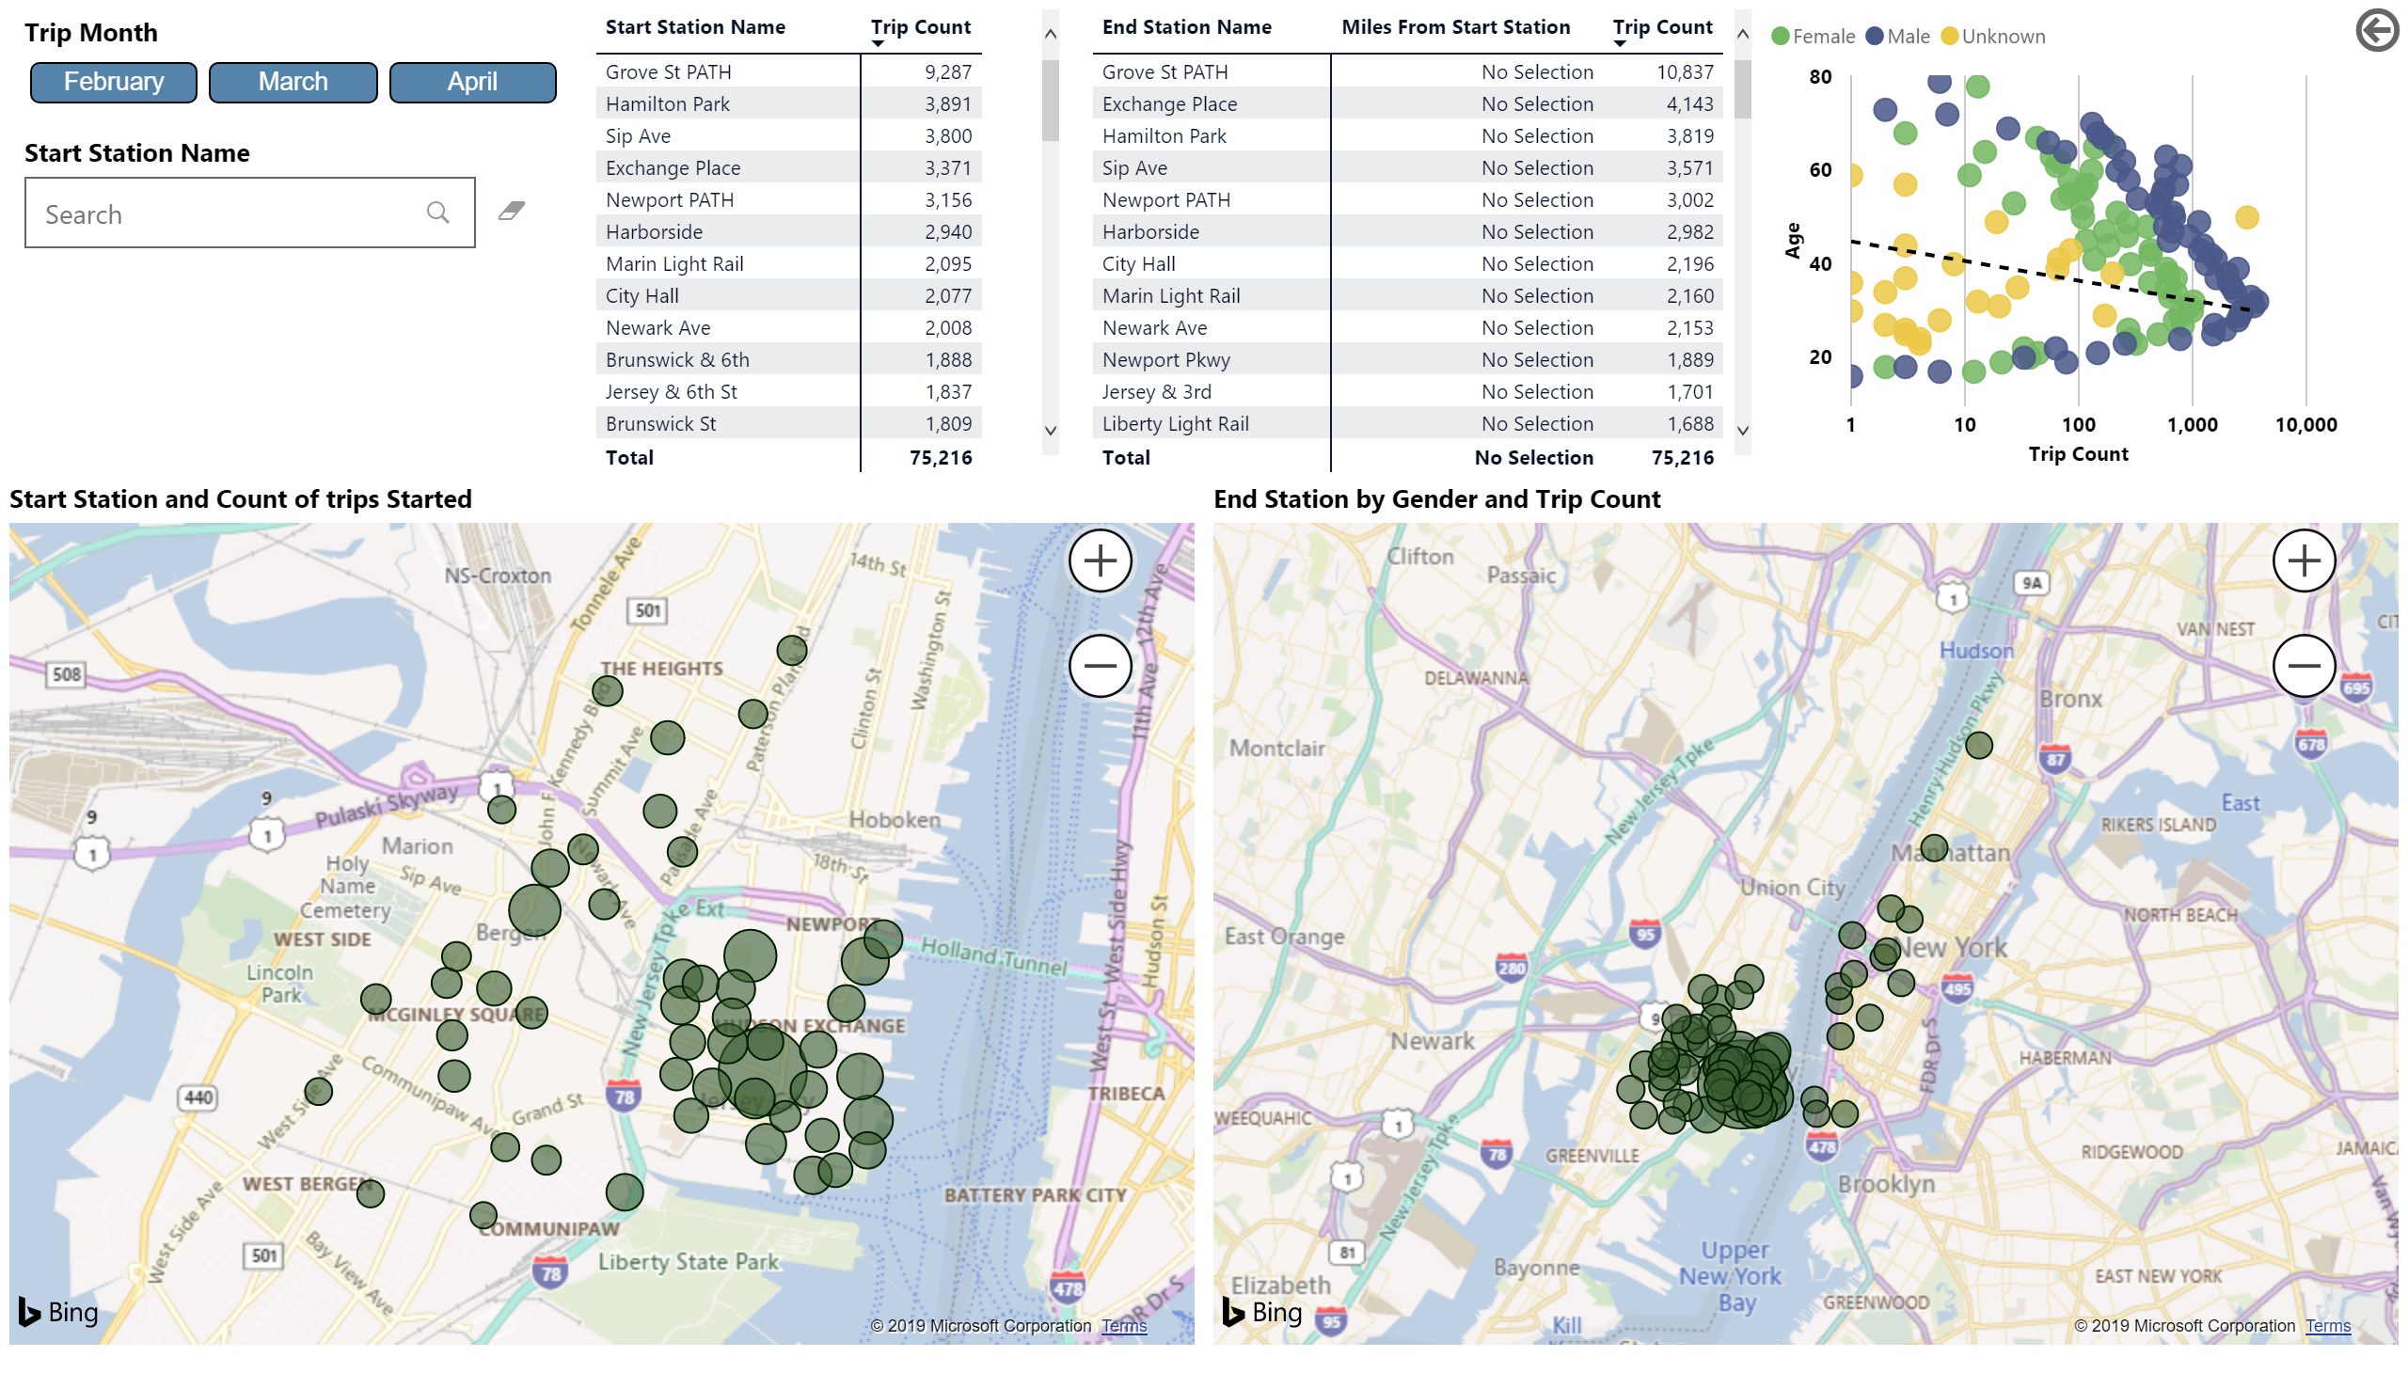
5
4

Slide 5
Insights – February to April 2019
Between February and April 2019, total number of trips increased by 78%
75k trips using 503 bikes
Overall, male participation dropped from 77% to 72% and female went up from 20% to 21% between February and April
Males around the age of 32 seems to use the bikes most frequently
Most trips start from Jersey City and end in Hamilton Park which is approximately .50 miles from station to station

